Slide 1
SCDMH Telepsychiatry :
Hospital Emergency Departments,
Community Mental Health Centers and Mental Health Clinics

Slide 2

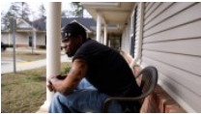
Deaf Resident Strikes the Right Note with Telemedicine
https://www.scetv.org/

Slide 3
SCDMH…
Providing Telepsychiatry Services since 1996
The Deaf Services Program at the South Carolina Department of Mental Health was one of the earliest adopters of video technology, starting in 1996 to use telepsychiatry to meet the needs of patients who wanted direct communication with their doctor or counselors.

Slide 4
Emergency Department Telepsychiatry
Collaboration of Historical Significance
The South Carolina Department of Mental Health partnered with The Duke Endowment to create in December 2007 an innovative solution to the overcrowding of psychiatric patients in local hospital emergency departments.
The solution was called “Partners in Behavioral Health Emergency Services.” Informally, it is referred to as the “SCDMH Emergency Department Telepsychiatry Program.”
It is a cutting-edge statewide service delivery model that provides remote access for emergency departments in South Carolina to psychiatrists whenever a psychiatric evaluation is required.
With on-going program evaluation from the University of South Carolina, School of Medicine, early financial support from the South Carolina Department of Health and Human Services, and initial program support from the South Carolina Hospital Association, the Program is a critical component to meeting the increased demand on emergency departments to treat psychiatric and co-occurring disorder patients.
The approach is to impact the demand for services at the service-delivery point with a product that will augment the limited resources available in the emergency departments. The solution is the SCDMH Emergency Department Telepsychiatry Program. It is the first of its kind nationally.

Slide 5
Community Telepsychiatry began…
The Community Telepsychiatry Program started because of the need for full spectrum community mental health services in rural areas across the state.
Built on the success of the SCDMH Emergency Department Telepsychiatry Program, SCDMH has equipped its community mental health centers and mental health clinics to provide psychiatric treatment services to its patients via Telepsychiatry.
The Community Telepsychiatry Program has provided psychiatric treatment services to SCDMH patients throughout South Carolina since August 2013.

Slide 6
86,000
Comprehensive Emergency Room Evaluations & Direct Patient Services via Telehealth
Record Breaking

Slide 7
Today, we have 4 Programs
Deaf Services Telepsychiatry
Emergency Department Telepsychiatry
Community Telepsychiatry
Inpatient Telepsychiatry

Slide 8
Emergency Department (ED) Telepsychiatry

Slide 9
Program Information
40,000+ successful comprehensive evaluations in 9 years
Approximately 525 comprehensive evaluations per month
18 Psychiatrists in full and part-time capacity
Operating Hours: 7am to 12am (Sun-Thurs)
7am to 1am (Fri-Sat)
365 days a year
23 hospitals under contract
5 state/regional/national awards

Slide 10
Participating Hospitals
Abbeville Area Medical Center | Mary Black-Gaffney Medical Center
AnMed Health Medical Center - Anderson | McLeod - Clarendon
Carolinas Hospital System - Florence | McLeod - Dillon
Carolinas Hospital System - Marion | McLeod - Florence
Chester Regional Medical Center | Spartanburg Regional Healthcare System
Coastal Carolina Hospital | Springs Memorial Hospital
Conway Medical Center | Tidelands Health - Georgetown Memorial Hosp.
Edgefield County Hospital | Tidelands Health -Waccamaw Community Hosp.
Fairfield Memorial Hosp. | Toumey Regional Medical Center
GHS- Laurens County | Union Medical Center
Hampton Regional Medical Center | Williamsburg Regional Hospital
Hilton Head Hospital

Slide 11
Community Telepsychiatry

Slide 12
Program Information
47 Psychiatrists in full or part-time capacity.
Approximately 1,500 services are provided each month.
Since August 2013, the Community Telepsychiatry Program has provided more than 44,000 psychiatric treatment services.

Slide 13
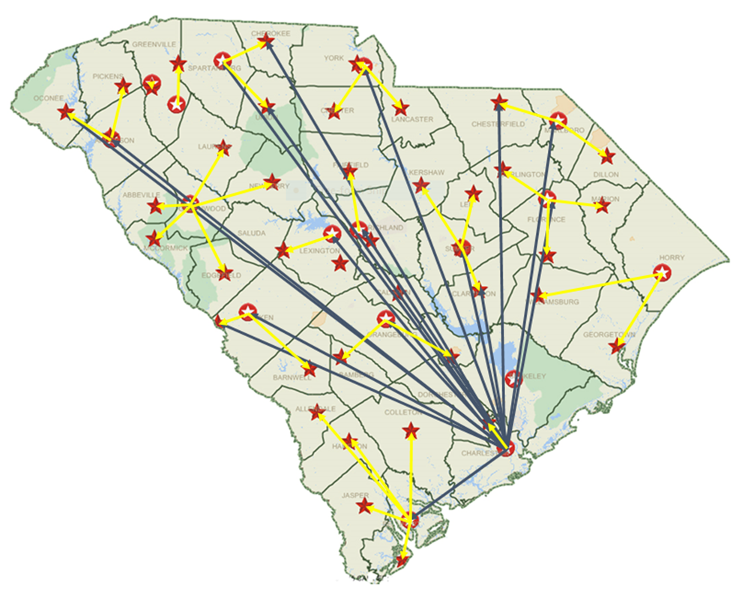
Community Telepsychiatry Interconnectivity
The interconnectivity of SCDMH’s Telepsychiatry Programs creates statewide access.

Slide 14
“Anytime, Anywhere, Anyhow”

Slide 15
Future of Telepsychiatry
Program Expansion: ED Telepsychiatry Program
New Program Pilot: Geriatric Telepsychiatry
New Program Pilot: FQHC Partnership/Primary Care
Utilization of Nurse Practitioners and MHPs
Just to name a few…

Slide 16
Telepsychiatry is the future of
SCDMH’s mission to support the
recovery of people with mental illnesses.

Slide 17
Additional Resources
https://www.scetv.org/
http://www.sctelehealth.org/
http://www.state.sc.us/dmh/services.htm
Contact Information:
Stewart Cooner – stewart.cooner@scdmh.org
Victoria Gooch – victoria.gooch@scdmh.org

